Slide 1
REAL ESTATE WHOLESALING ANALYSIS

Slide 2
🔍 Locate Properties To Buy 📞 Skip Trace and Contact The Owner(s) 💰 Determine Properties Value 🔧 Estimate Repairs and Maximum Allowable Offer (MAO) 💬 Negotiate Price and Get Property Under Contract 📸 Get more pictures of Property 📣 Market Contract To Find Buyer 💼 Negotiate with Buyer and Sign Assignment Contract 🏠 Bring both contracts to Wholesale Friendly Tile Company 💸 Get Paid"
STEPS TO
WHOLESALING

Slide 3
ARV (AFTER REPAIR VALUE)
INVESTOR 1
ARV
- REPAIRS
x 70% RULE
- WHOLESALE FEE
INVESTOR 2
ARV
x 70% RULE
- REPAIRS
- WHOLESALE FEE
INVESTOR 3
ARV
X 0.98
- REPAIRS
-PROFIT
- WHOLESALE FEE

Slide 4
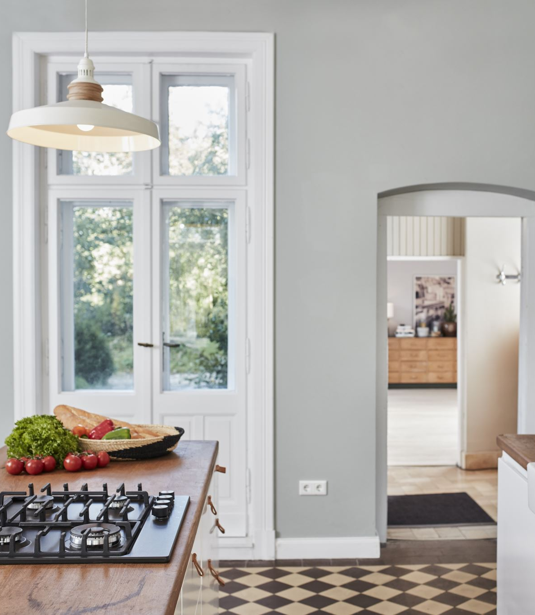
REPAIR COSTS
Light Repairs = $10 - $20/Sqft
Carpet and Paint
Average Repairs = $25 - $40/Sqft
Floors, kitchen, bathroom, paint, lights
Gut Job Repairs = $45 - $60/Sqft
Walls, paint, kitchen, bathroom, roof (maybe), floors, windows, doors, etc.

Slide 5
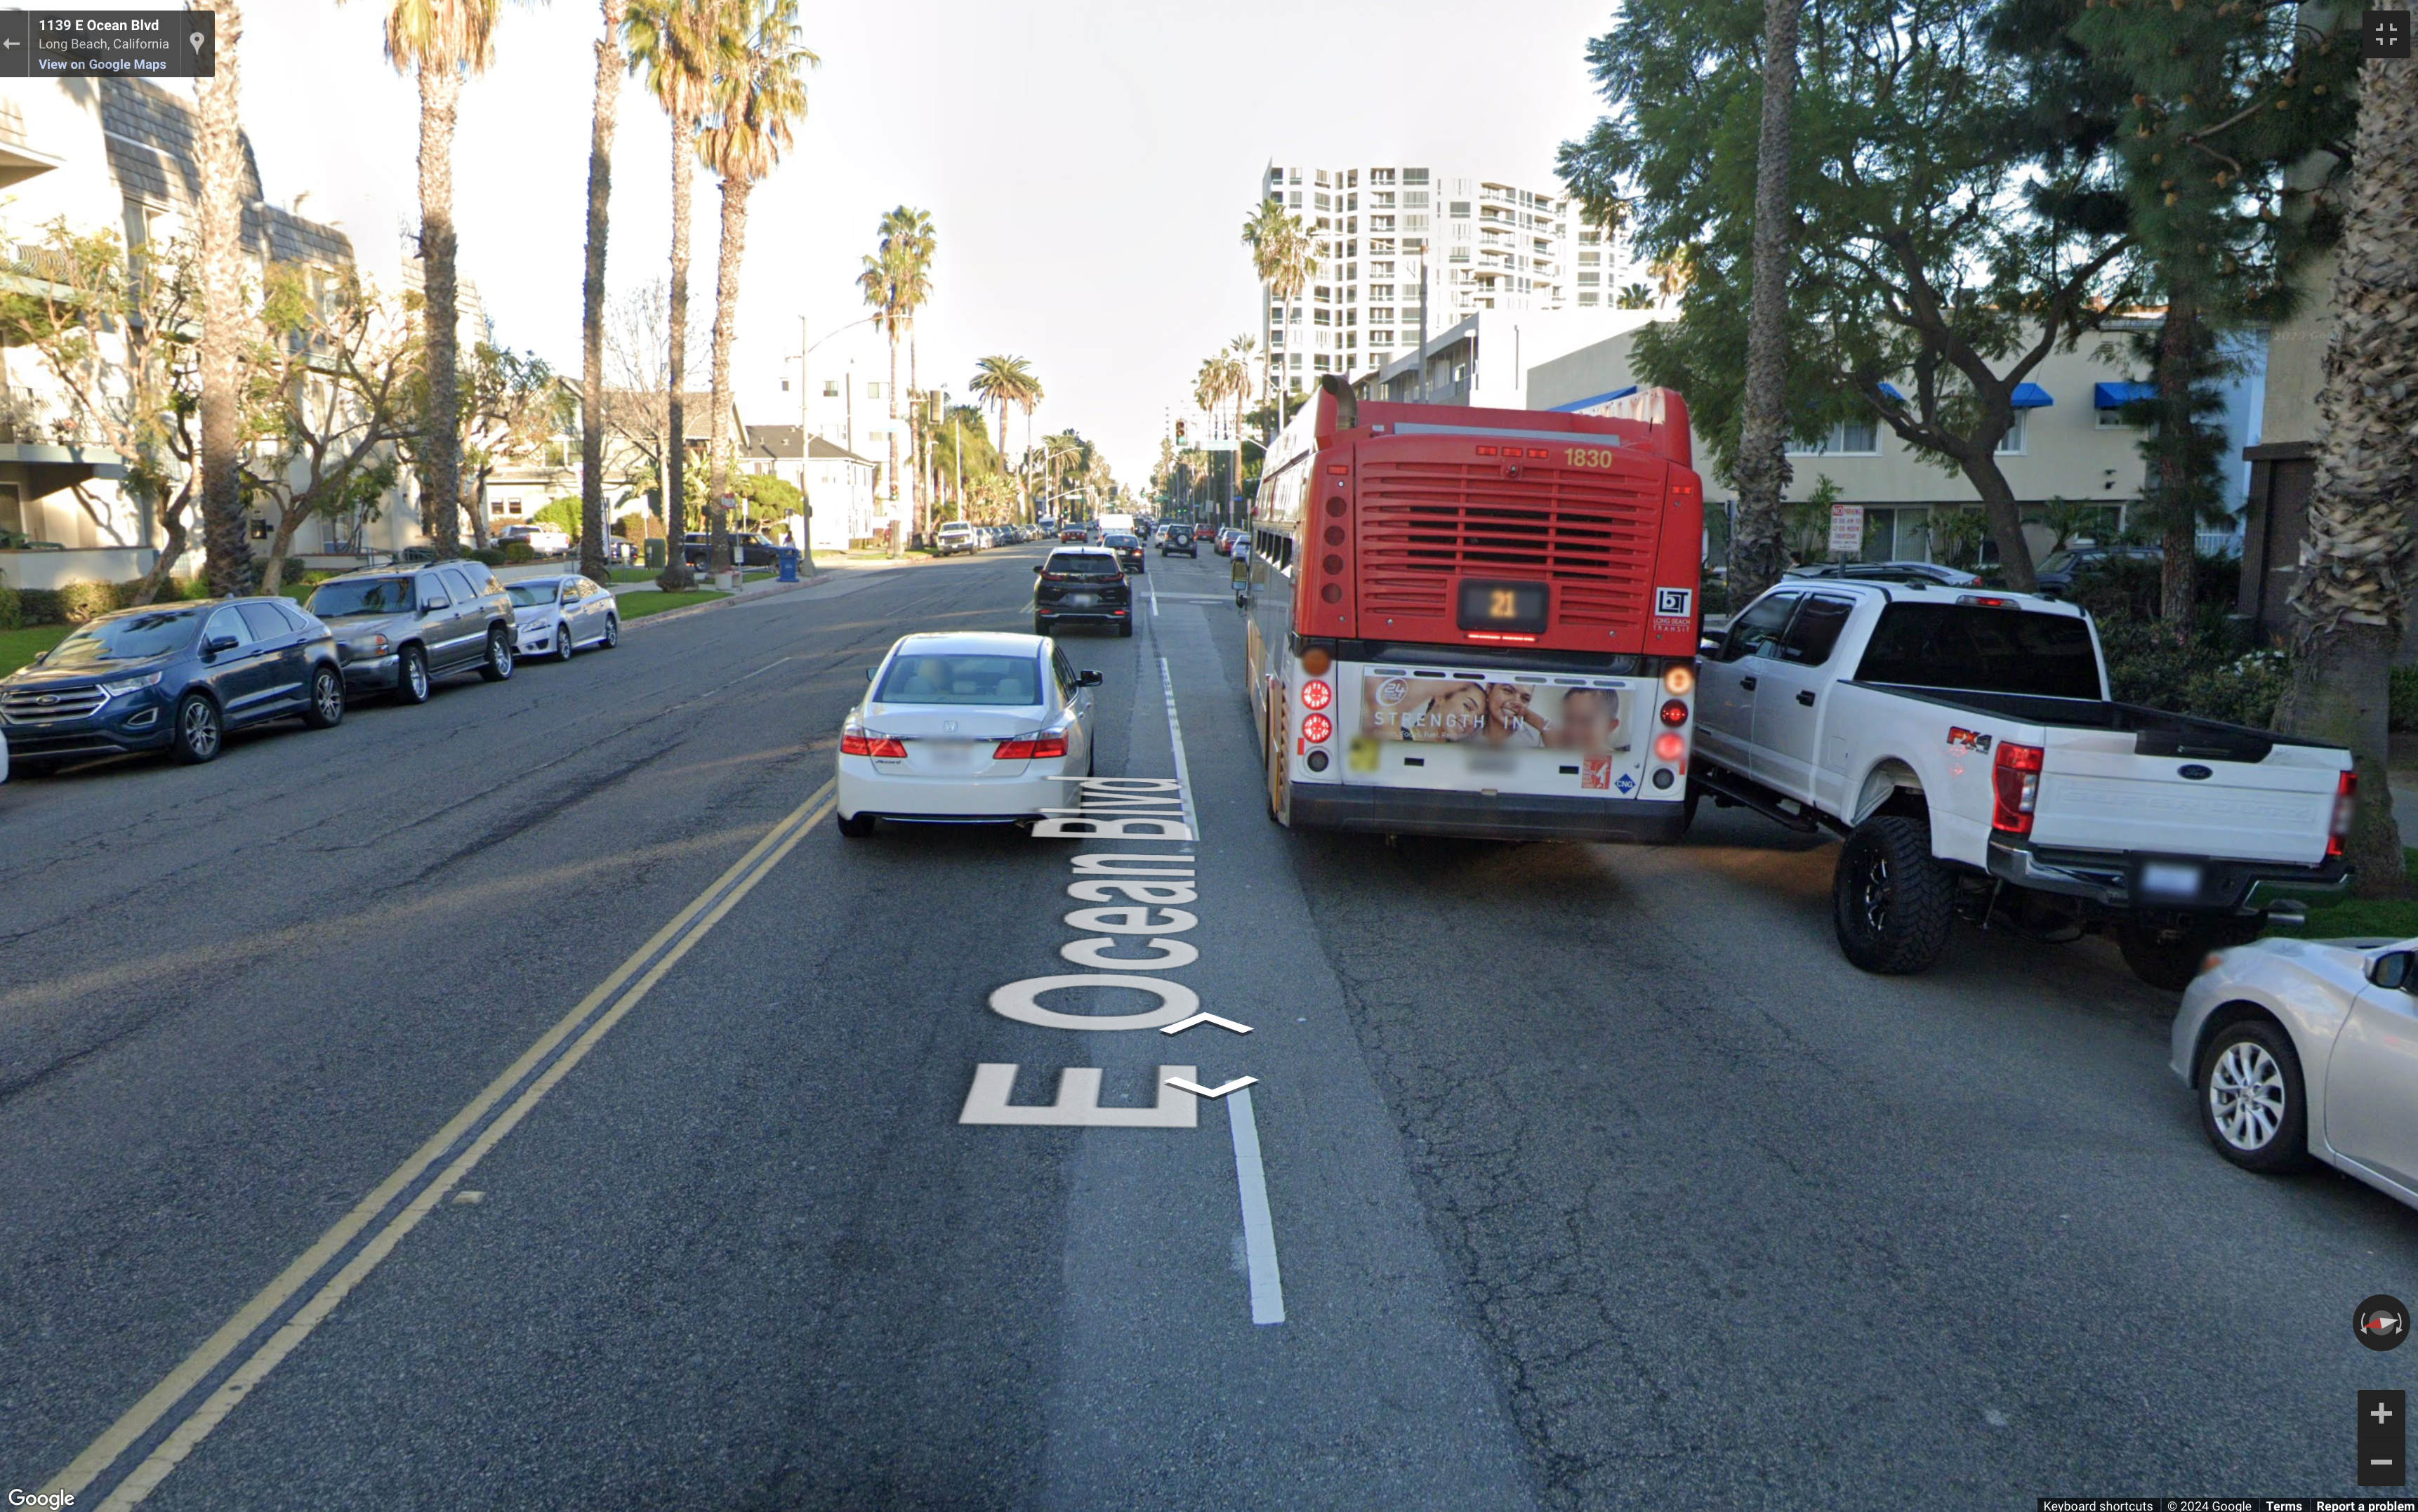
COMPS PARAMETERS - + 300 sqft living space - + 2,500 sqft lot size 1/2 mile - 1 mile radius for comps DO NOT CROSS DOUBLE YELLOW LINES ROADS - + 10 years age difference 3-5 Comps (updated)

Slide 6
Contingencies When Submitting an Offer - Close 21 days - 30 days after signing - Pay Closing Fees - 1% EMD (Earnest Money Deposit) - 15 Business Day Inspection Period (Mon - Fri. 9 am - 5pm Only)
*EMD TO BE DEPOSITED BEFORE/WHEN DONE WITH INPSECTION PERIOD
*EMD SENT TO TITLE CO.

Slide 7
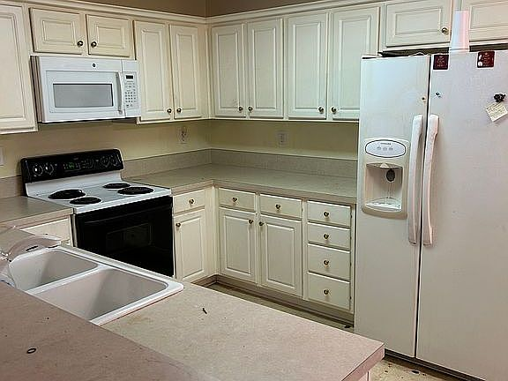
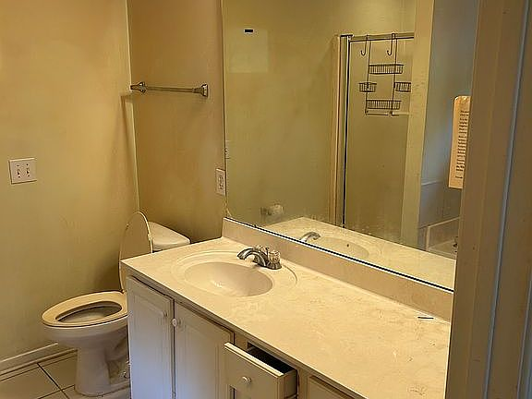
DEAL
NO DEAL
PROPERTY
Seller asking: $159,000
2 bed / 2 bath / 1,192 sqft
On Zillow for 61 days
Listed as FSBO (for sale by owner)
Last Price Cut $31k (11/27)
1724 Young Pointe Blvd, Montgomery, AL 36106

Slide 8
DEAL
NO DEAL
ANALYSIS
Price = $159,000
Closing fees = $15,900 (10%)
Repairs = $42,000 ($35/sqft)
Investor Profit = 15%
ARV NEEDED = $249,500

Slide 9
DEAL
NO DEAL
COMPS
Comp 1 = $102.88/sqft
Comp 2 = $123.5/sqft
Comp 3 = $120/sqft
= $115.5/sqft x 1,192 sqft
= $137,676 ARV

Slide 10
DEAL
NO DEAL
OFFER + Negotiating
Seller Asking = $159,000
ARV $140,000
Investor Rule 70% = $42,000
Repairs = $42,000
---------------------------
Buyer Purchase = $56,000
Wholesale Fee = $10,000
-------------------------------------
MAO = $46,000
$36,000
$41,000
$46,000
$51,000
WHOLESALE FEE = $5,000

